Slide 1
Glove For Deaf
AMIT Graduation Project ‘22

Slide 2
Team Members

Slide 3
Ziad Elbouriny: zizoelbouriny164@gmail.com
Mostafa Khaled: mostafakhaled513@gmail.com
Mostafa Mohamed: 4ikawy.mo7amed@gmail.com

Slide 4
Project Details

Slide 5
Making a glove to read the hand signs of deaf people to know are they saying by displaying the sentence on LCD.
There are 7 signs needed to be considered, they are: “I love you”, “You”, “I watch you”, “I really love you”, “I wish you good life”, “That is fantastic” and “Good job”.
We need to save the sentences in an EEPROM, we used the internal one to store in it our signs.
We also need to display on the LCD on both lines due to the long sentences.

Slide 6
What we did?

Slide 7
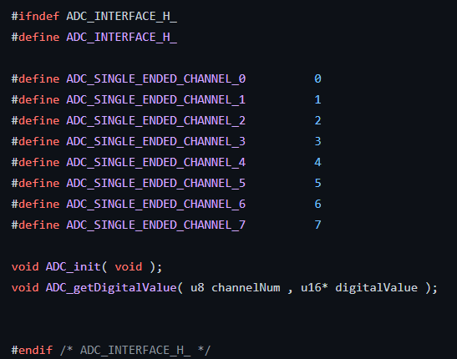
ADC
Those are the functions needed for it.

Slide 8
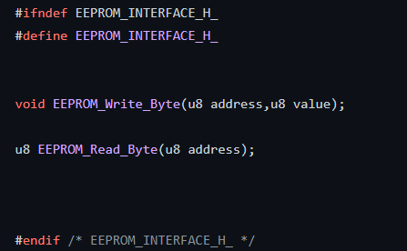
2. EEPROM
Those are functions needed for it.

Slide 9
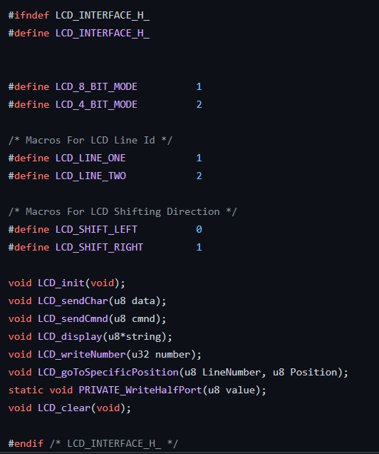
3. LCD
Those are functions needed for it.

Slide 10
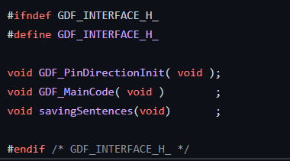
Main Functions
Those are functions needed for it.

Slide 11
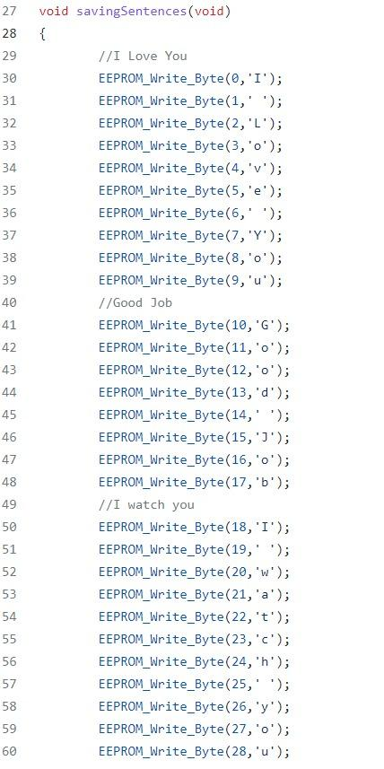
Main Project Code
Saving sentences in EEPROM

Slide 12
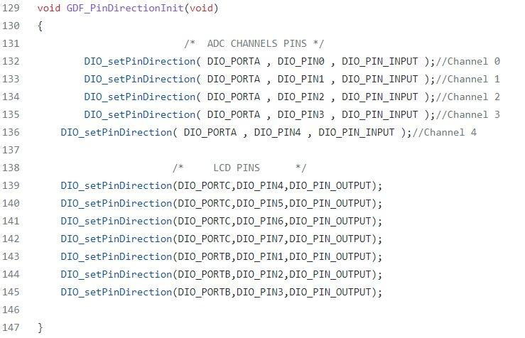
Setting Pins

Slide 13
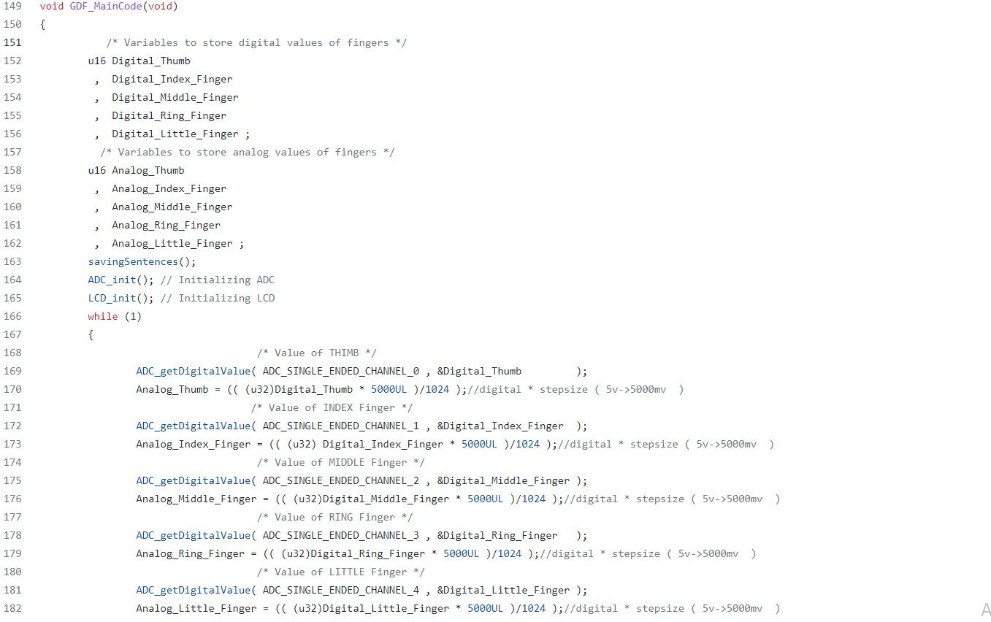
Main Code

Slide 14
Some of our O/Ps

Slide 15
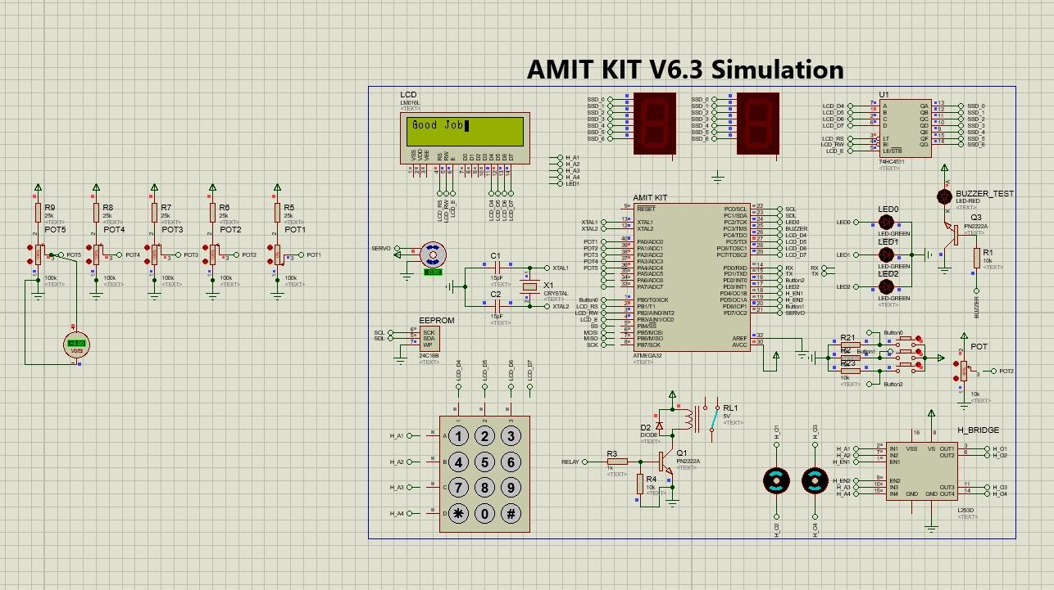

Slide 16
